Slide 1

Agentic RAG Chatbot for Multi-Format Document QA
Leveraging Model Context Protocol (MCP) for enhanced performance.
Submitted By : Anumolu Anitha

Slide 2
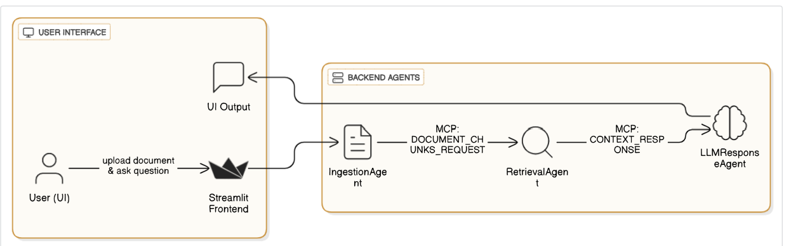

System Architecture: Agent-Based RAG with MCP

Slide 3

Model Context Protocol (MCP)
MCP is the standardized message format facilitating communication between agents.
{ "sender": "RetrievalAgent",
"receiver": "LLMResponseAgent",
"type": "CONTEXT_RESPONSE",
"trace_id": "xyz-123",
"payload": {
"query": "What are the KPIs?",
"top_chunks": ["chunk1...", "chunk2..."]
}}
Benefits of MCP:
Traceable message flow
Clear agent separation
Debug-friendly structure

Slide 4
Tech Stack
🧠 Backend:
💬 Communication:
Python 3
Custom MCP format (JSON-like)
FAISS (vector store)
🖥️ Frontend:
Sentence Transformers
HuggingFace Transformers (DistilBERT)
Streamlit (UI for file upload + chat)
📄 Supported File Types:
PDF, DOCX, PPTX, CSV, TXT, Markdown

Slide 5
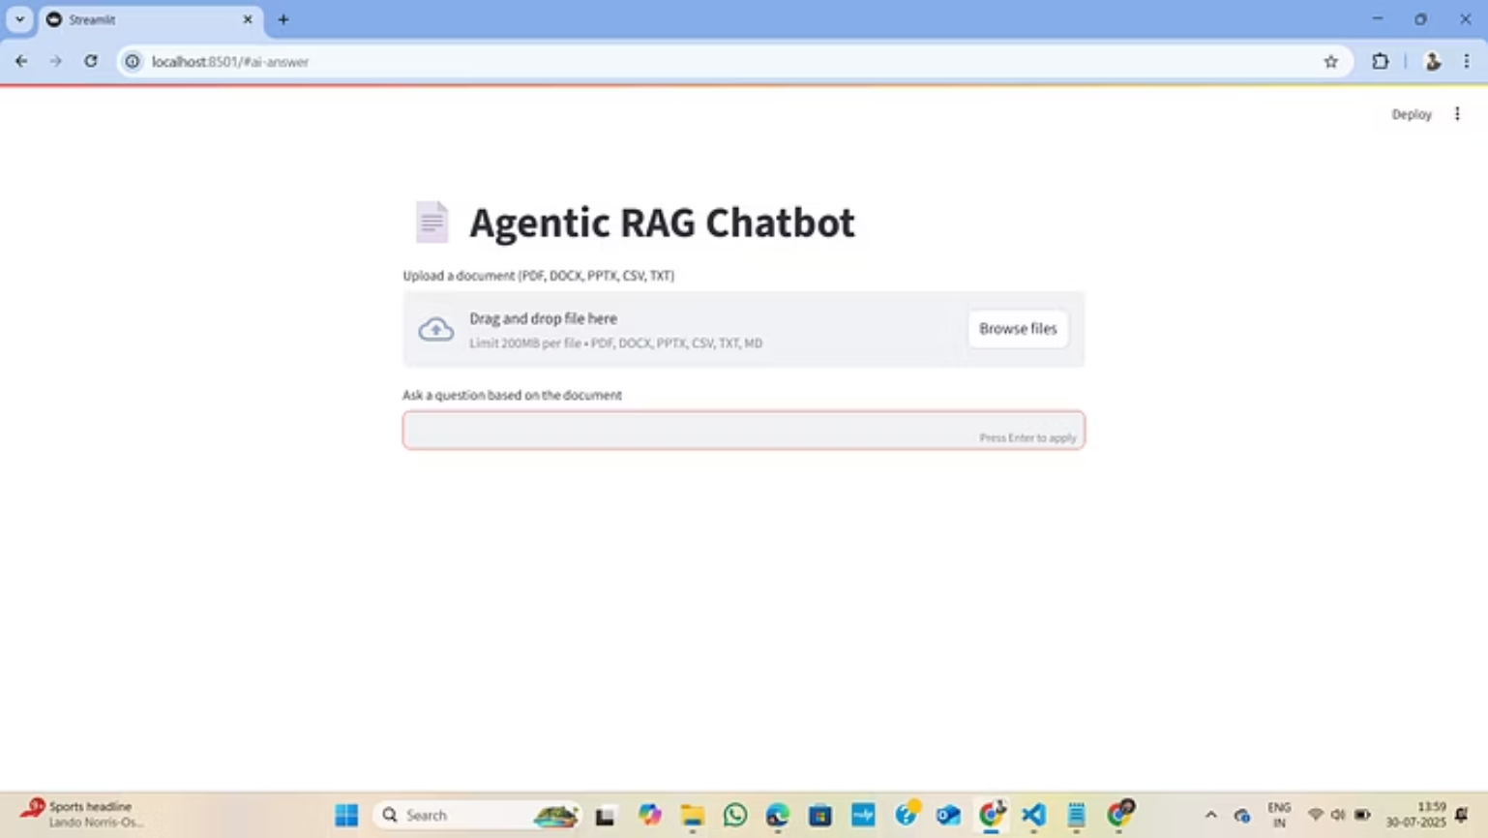
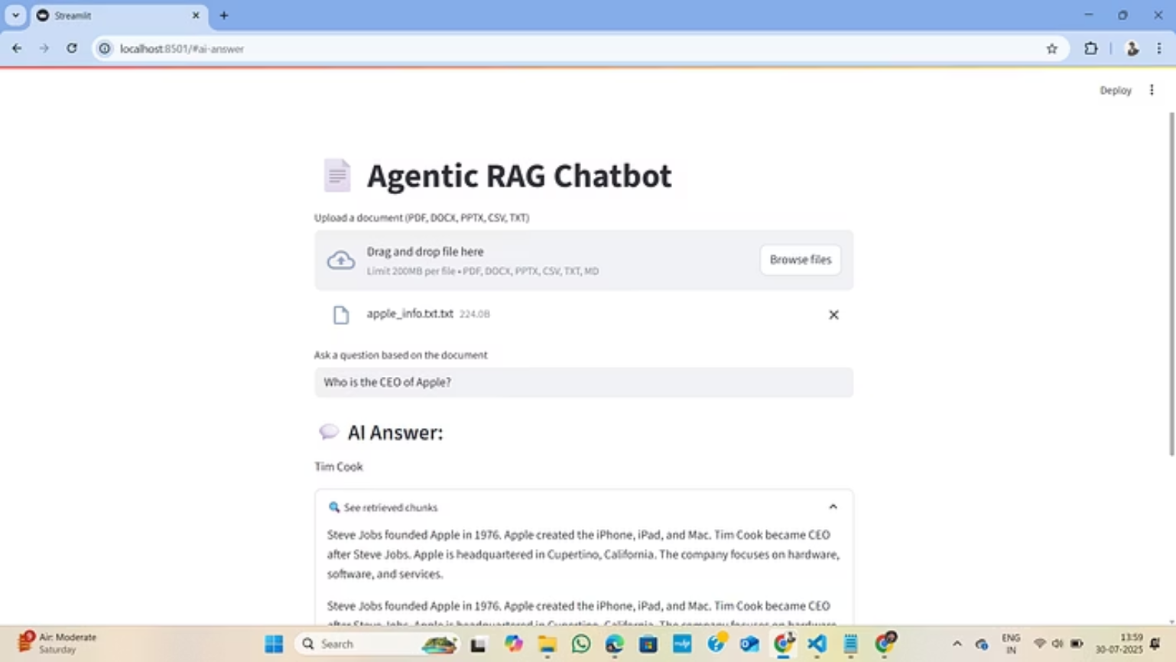

UI Screenshots
Caption: User uploads file and asks: ‘Who is the CEO of Apple?’ → Answer: ‘Tim Cook’

Slide 6
Challenges Faced
Streamlit Errors
Model Download Delays
Inconsistent Formatting
Resolved import path issues for smoother operation.
Optimized initial model loading for faster first-run experience.
Improved handling of varied DOCX/PPTX formats for robust parsing.

Slide 7


Future Improvements
Add Memory (Multi-Turn)
PDF Page Source References
Enable conversational context for follow-up questions.
Provide precise page numbers for answers from PDF documents.
UI for File History & Download
Use Local Models
Implement features for managing past uploaded files.
Integrate models like Mistral or LLaMA for offline capabilities.

Slide 8



Summary
Working Chatbot
Multi-Format Support
Complete and functional document Q&A system.
Handles various document types seamlessly.
Agent + MCP Structure
Cost-Effective
Robust and scalable architecture.
Utilizes free HuggingFace models, eliminating billing needs.

Slide 9

Key Takeaways
"Our Agentic RAG Chatbot provides a powerful, efficient, and flexible solution for multi-format document Q&A, designed for scalability and ease of use."
The integration of the Model Context Protocol ensures seamless communication and a robust framework for future enhancements.

